Slide 1

Evolution of plant pathogens: how can L. acicola genetic data inform loblolly needle blight management?
Janna Willoughby, jwilloughby@auburn.edu
College of Forestry, Wildlife, and Environment
Auburn University

Slide 2





Genetics Team
Interested in evolution and genetics, and in particular how genetic variants relate to specific traits
Temitope Folorunso
Ph.D. student
Gabriel Silva
Ph.D. student
Samantha Huey
undergraduate student
Mick Persyn
Undergraduate student

Slide 3

Genome sequencing and agricultural pathogens
Analyze complete genetic makeup of causative agents of plant diseases
Understand pathogen characteristics and interaction with host phenotypes

Slide 4
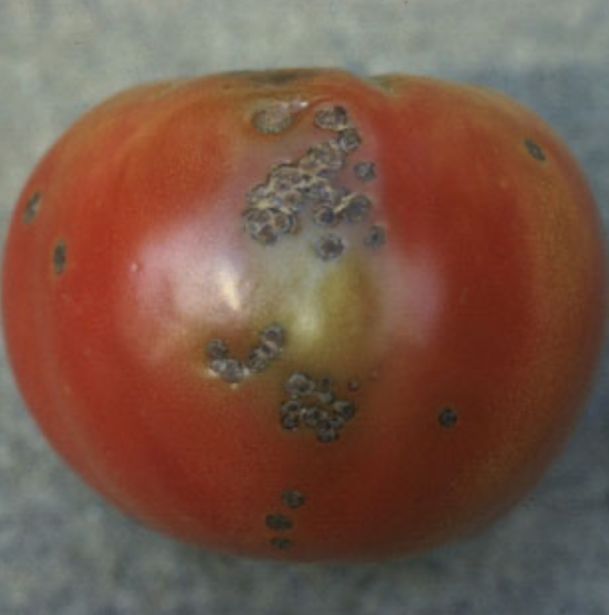
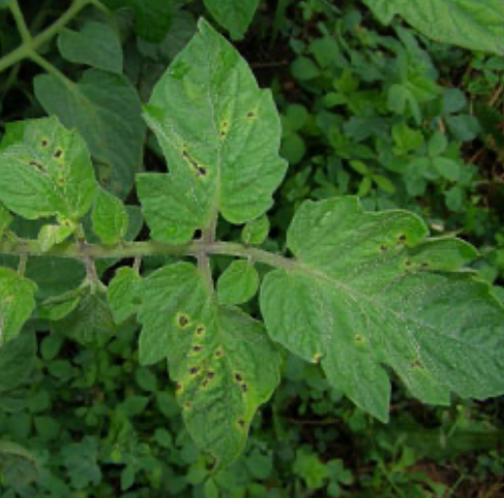
Pathogen evolution and characteristics
Identify genes responsible for causing disease symptoms
Understand evolution and invasion pathways
Tomato bacterial spot caused by Xanthomonas vesicatoria
Bianco et al. 2023

Slide 5
Tomato bacterial spot
Use genome data to characterize disease mechanisms that point towards treatments
exp.
sequence pathogen genomes
note tomato disease symptoms
find genetic variants (SNPs)
connect expression to SNP frequency
AATCGAATTCCGGA
AATCGAATTCCGGA
AATCGAATTCCGGA
AATCGAACTCCGGA
AATCGAACTCCGGA
AATCGAACTCCGGA
AATCGAATTCCGGA
AATCGAATTCCGGA
AATCGAATTCCGGA
AATCGAATTCCGGA
AATCGAATTCCGGA
AATCGAATTCCGGA
Bianco et al. 2023

Slide 6
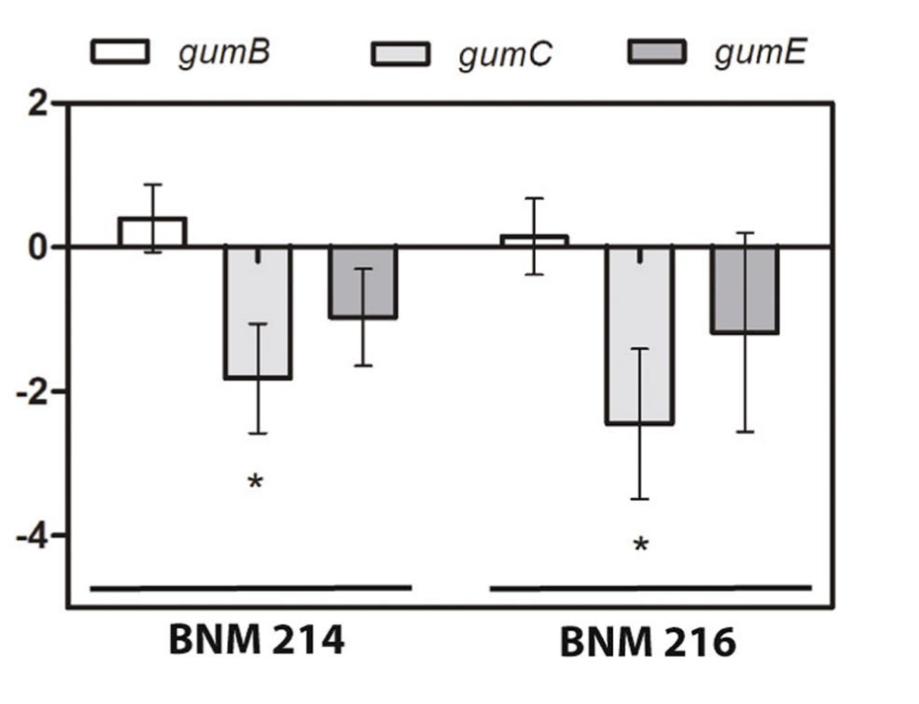
Tomato pathogen mode of action
Pathogen strains had varied biofilm viscosities
Identified genes that were expressed differently and were related to biofilm viscosity
genes related to biofilm viscosity
Gene expression differences
pathogen strains
Bianco et al. 2023

Slide 7
Implications for reducing tomato losses
Devise treatments for limiting bacterial biofilm
Deploy treatment where strains with high expression of gumC/gumE are found
Location-specific application reduces treatment resistance evolution
genes related to biofilm viscosity
Gene expression differences
pathogen strains
Bianco et al. 2023
Notes:
Viscosity diff likely a result of chain length for particular protein

Slide 8
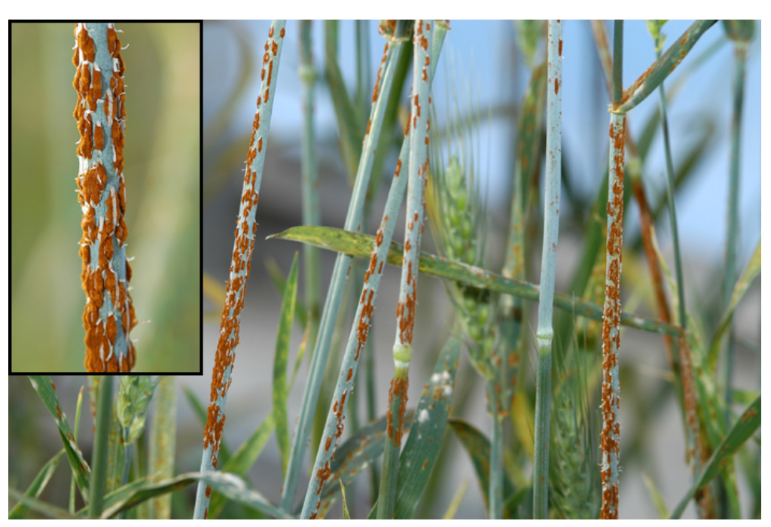
Pathogen evolution and characteristics
Identify genes responsible for causing disease symptoms
Understand evolution and invasion pathways
Wheat stem rust caused by Puccinia graminis f.sp. tritici (Pgt)
Guo et al. 2022

Slide 9
Wheat stem rust
Use genome data to determine how selection and pathogen lineages combine to affect virulence
sequence pathogen genomes
note virulence for each lineage
find genetic variants (SNPs)
identify genome rearrangements
deletion
duplication
insertion
Guo et al. 2022

Slide 10
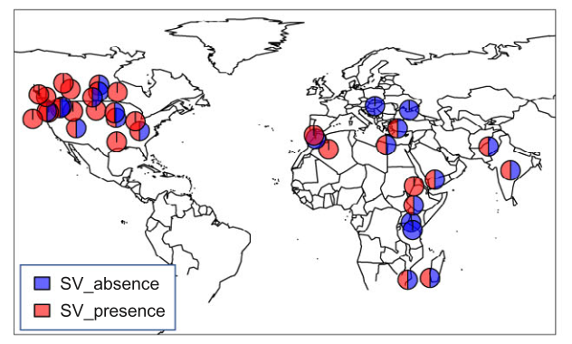
Genome rearrangements and virulence
Pathogen (Pgt) lineages were geographically structured
wild type
variant
Guo et al. 2022

Slide 11
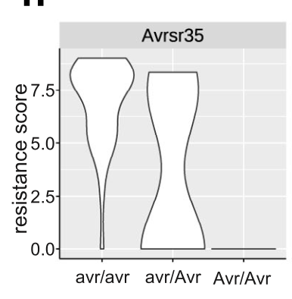
Genome rearrangements and virulence
Pathogen (Pgt) lineages were geographically structured
In some wheat genotypes, resistance decreased when pathogen (Pgt) structural variant was present
inverse of virulence, reflects host pathogen defense ability
wheat (host) genotypes
Guo et al. 2022

Slide 12
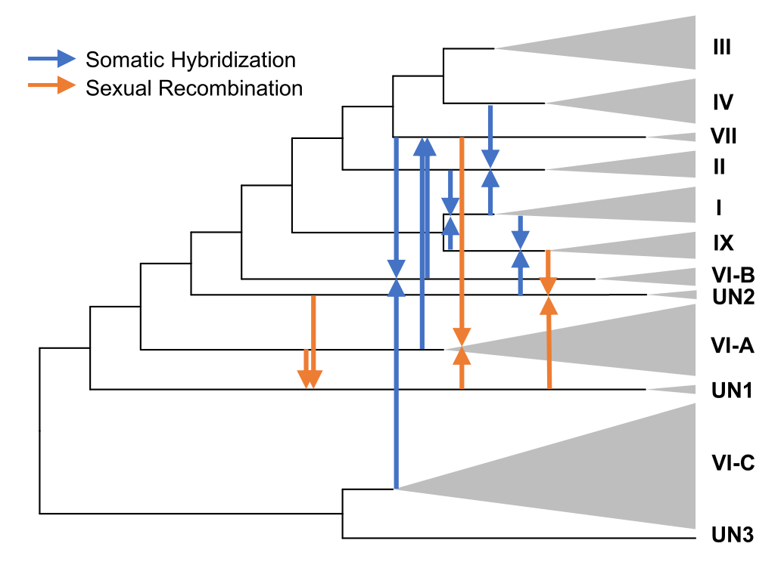
Implications for predicting virulence
History of genomic structural changes through evolutionary history related to virulence
Variants and movement of these variants between lineages influences virulence
Guo et al. 2022

Slide 13
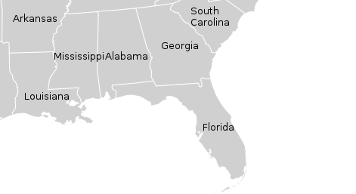
What about BSNB?
Identify pathogen sequence and structural variants that predict symptoms/progression
Quantify expression of symptom-related genes
Determine population structure and evolutionary history to provide predictive framework

Slide 14

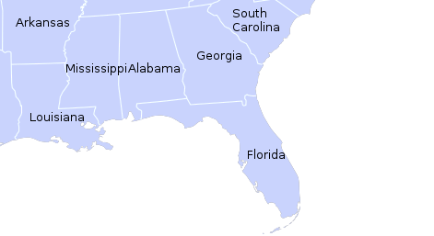
Progress and plans
Completed to date:
collect fungi from trees/needles
isolate and replicate fungi
determine fungal
ID with PCR
extract high
quality DNA
Alabama, interested in extending range
loblolly, interested in additional hosts

Slide 15
Progress and plans
Planned activities:
ATCG
trait 1 trait 2
exp.
sequence fungal genomes
identify genome variants
link variants
with traits
gene expression related to traits
Characterize L. acicola evolution to find treatment targets and mechanisms for limiting spread
characterize population structure
selection and dispersal patterns

Slide 16




L. acicola samples to analyze?
Interested in infected needles from
  Inside and outside southeast
  Loblolly, longleaf, and slash
Land Owners​:
Long Leaf Land & Timber Company​
Stallworth Land Company ​
Osko Forest: Dr. Glenn Glover​
sample submission instructions
Auburn Forest Health Dynamics Lab
jwilloughby@auburn.edu

